Slide 1
Context for single object classes

Slide 2
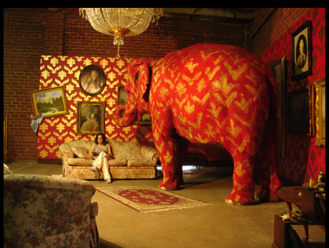
Who needs context anyway? We can recognize objects even out of context
Banksy
Notes:
Despite of being semantically wrong, some basic contextual principles are still preserved: the elephant is not sticking out of the wall.

Slide 3

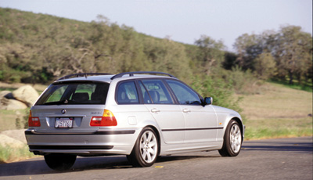
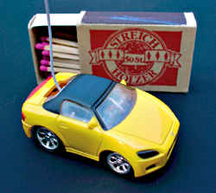
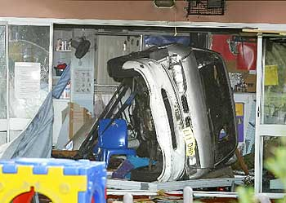
Why is context important?
Changes the interpretation of an object (or its function)
Context defines what an unexpected event is

Slide 4
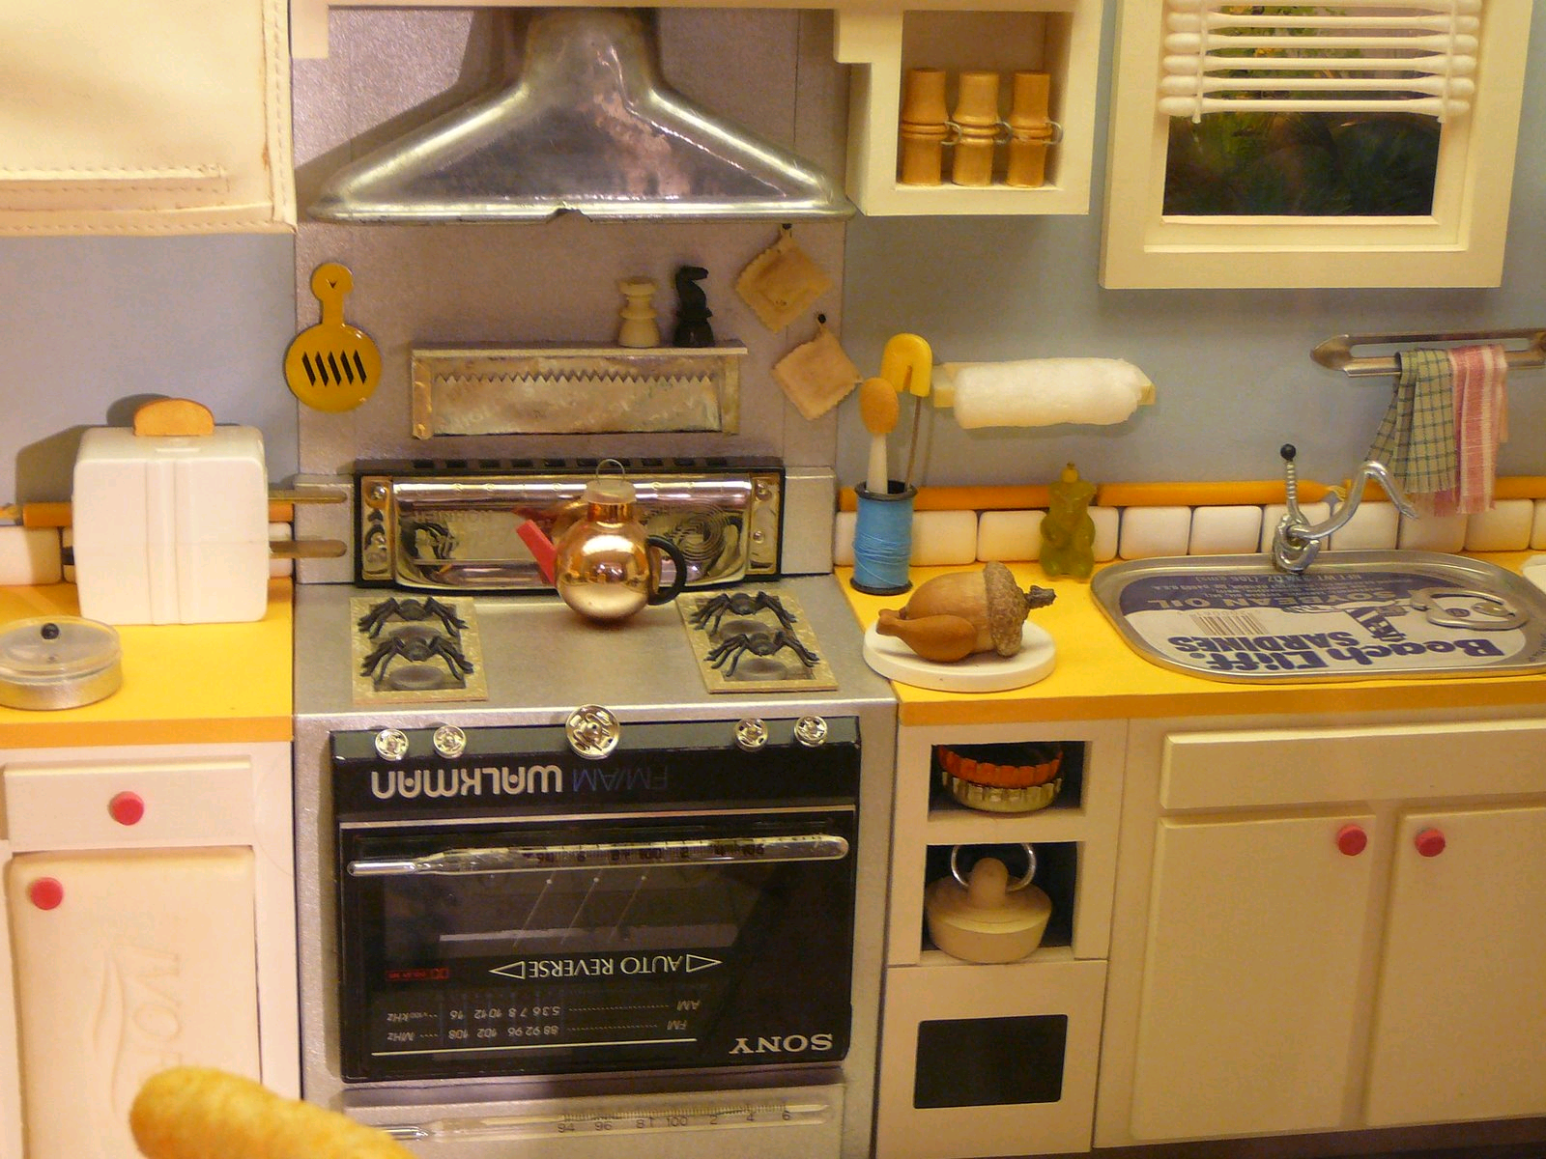
Look-Alikes by Joan Steiner
Even in high resolution, we can not shut down contextual processing and it is hard to recognize the true identities of the elements that compose this scene.

Slide 6

Notes:
Let’s just verify once more how amazing is the visual system

Slide 8
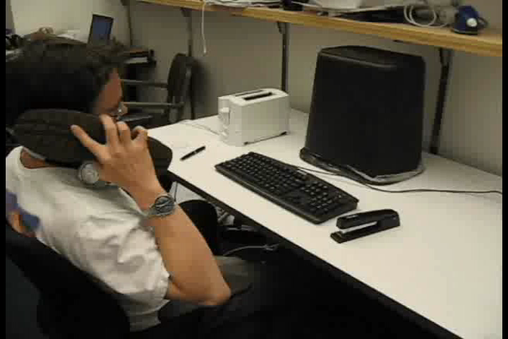

Slide 9
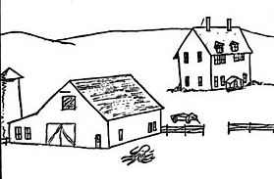
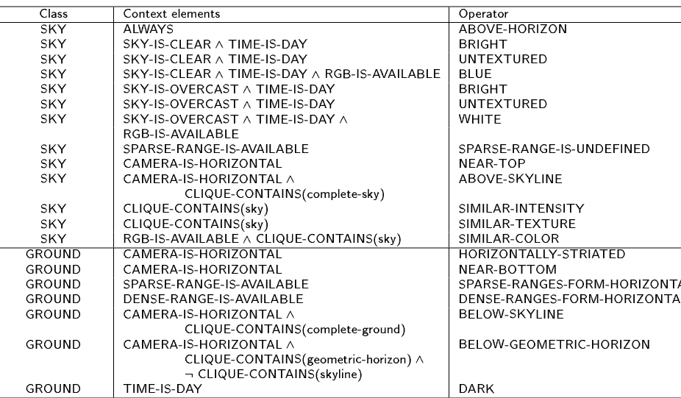
The importance of context
Cognitive psychology
Palmer 1975
Biederman 1981
…
Computer vision
Noton and Stark (1971)
Hanson and Riseman (1978)
Barrow & Tenenbaum (1978)
Ohta, kanade, Skai (1978)
Haralick (1983)
Strat and Fischler (1991)
Bobick and Pinhanez (1995)
Campbell et al (1997)

Slide 10
What is the context for a single object category?

Slide 11

The influence of an object extends beyond its physical boundaries

Slide 12
Global and local representations
building
car
Urban street scene
sidewalk
Notes:
There are many ways in which we can study context. The most natural one will be to characterize the relationships between all the candidate objects in the scene. So, instead of first segmenting the image into objects and then inferring the scene category, what I suggest is taking a different path.

Slide 13
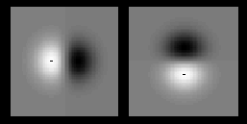
Global and local representations
building
car
Urban street scene
sidewalk
Image index: Summary statistics,
configuration of textures
histogram
Urban street scene
features
Notes:
The second representation …
Psychologist have been studying these kind of representations for some time, specially in the framework of fast scene presentations.

Slide 14



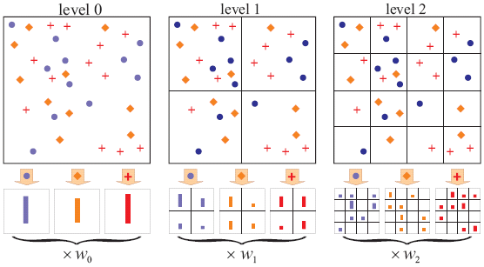
Global scene representations
Bag of words
Spatially organized textures
M. Gorkani, R. Picard, ICPR 1994
A. Oliva, A. Torralba, IJCV 2001
Sivic et. al., ICCV 2005
Fei-Fei and Perona, CVPR 2005
Non localized textons
Walker, Malik. Vision Research 2004
…
…
S. Lazebnik, et al, CVPR 2006
Spatial structure is important in order to provide context for object localization

Slide 15
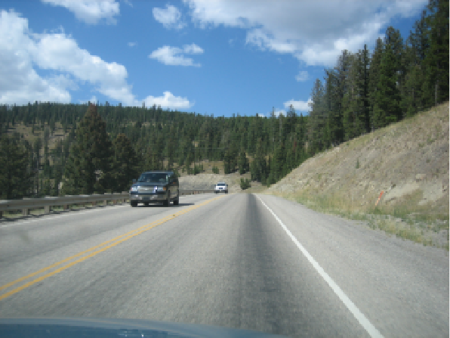
An integrated model of Scenes, Objects, and Parts
Scene
S
N_{car}
P(N_{car} | S = street)
1
5
N
0
g
P(N_{car} | S = park)
Scene
gist
features
1
5
N
0
Notes:
In this talk I will argue that by reasoning about the scene, globally, considering many objects simultaneously, it is possible to build more efficient object recognition systems. In this talk I will present my approach.

Slide 16
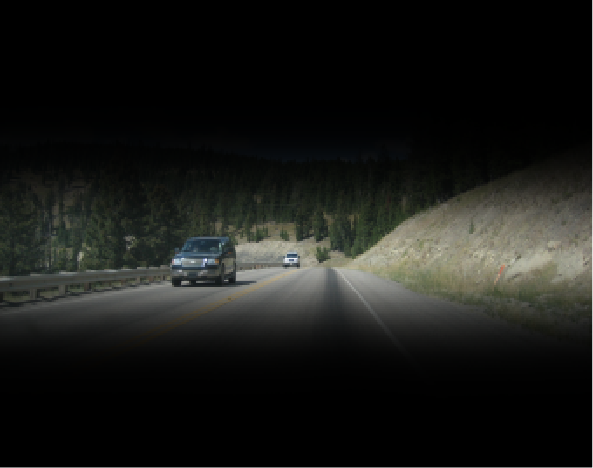
Context driven object detection
Scene
S
N_{car}
Z_{car}
P(N_{car} | S = street)
1
5
N
0
g
Scene
gist
features
Notes:
In this talk I will argue that by reasoning about the scene, globally, considering many objects simultaneously, it is possible to build more efficient object recognition systems. In this talk I will present my approach.

Slide 17
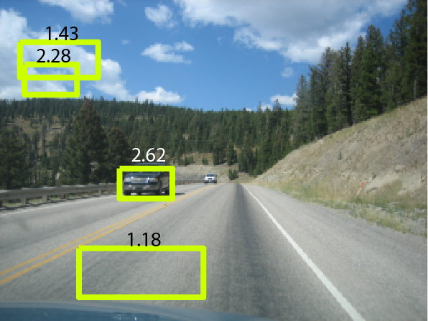
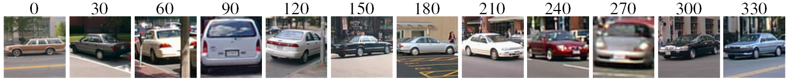
An integrated model of Scenes, Objects, and Parts
We train a multiview car detector.
car
p(d | F=1) = N(d | μ₁, σ₁)
F_{i}
p(d | F=0) = N(d | μ₀, σ₀)
d^{car}_{i}
x^{car}_{i}
N=4
Notes:
In this talk I will argue that by reasoning about the scene, globally, considering many objects simultaneously, it is possible to build more efficient object recognition systems. In this talk I will present my approach.

Slide 18
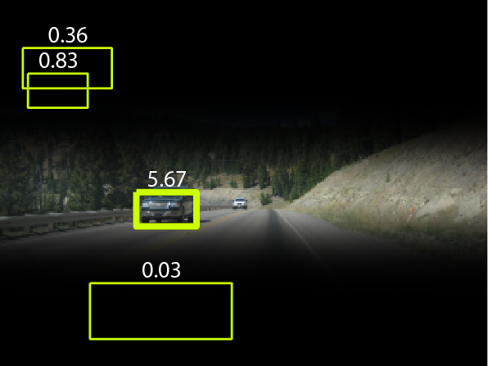
An integrated model of Scenes, Objects, and Parts
Scene
S
N_{car}
Z_{car}
car
F_{i}
g
d^{car}_{i}
x^{car}_{i}
Scene
gist
features
M=4
P(F,S | x,d,g) α p(F | S)p(S | g) p(x_{i} | g) ΠN(x_{i}; μ_{b}, σ_{b}²) ΠN(d_{i}; μ_{tp}, σ_{tp}²) ΠN(d_{i}; μ_{tn}, σ_{tn}²)
i:F_{i}=0
i:F_{i}=1
i:F_{i}=0
Notes:
In this talk I will argue that by reasoning about the scene, globally, considering many objects simultaneously, it is possible to build more efficient object recognition systems. In this talk I will present my approach.

Slide 19
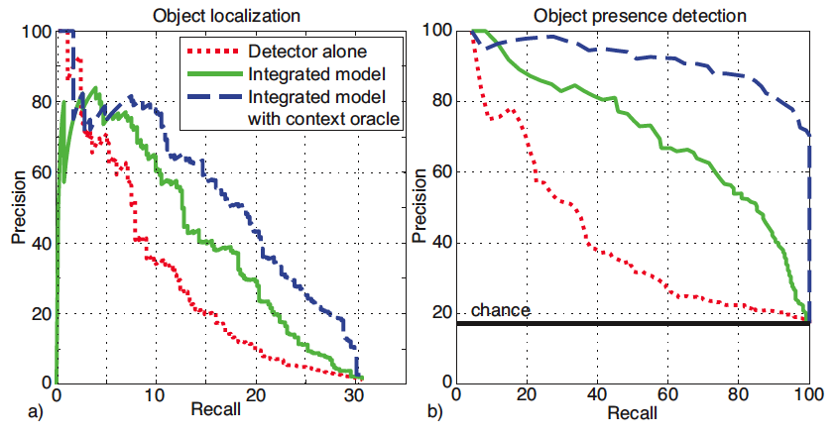

Slide 20
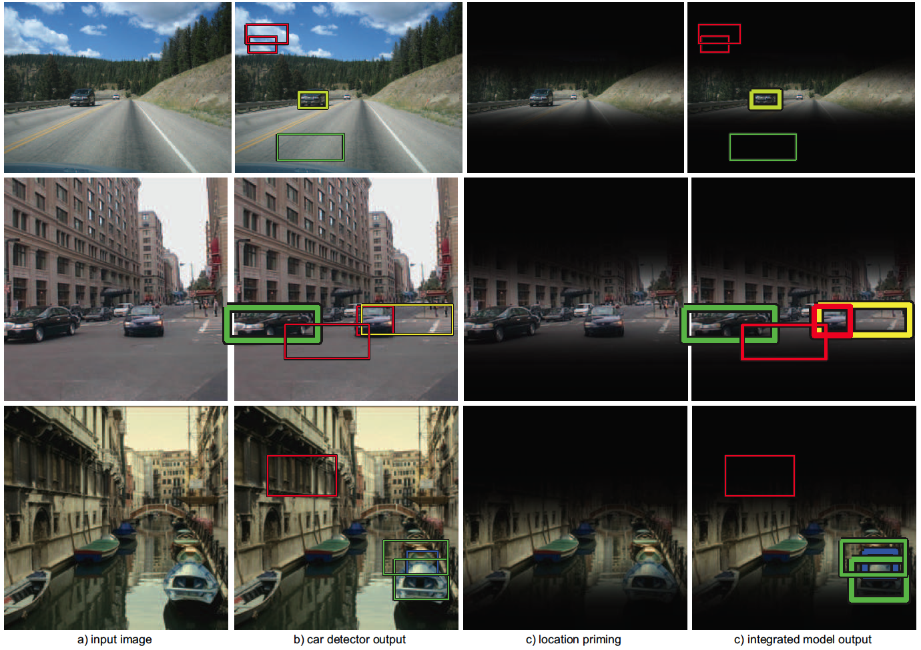

Slide 21
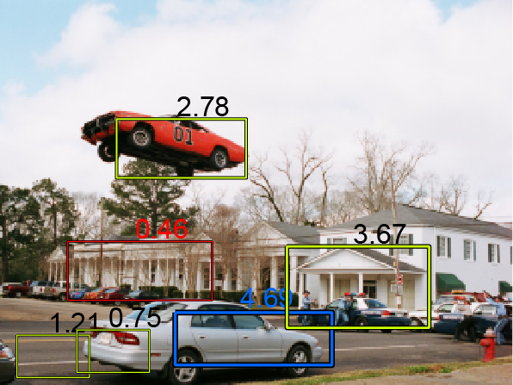
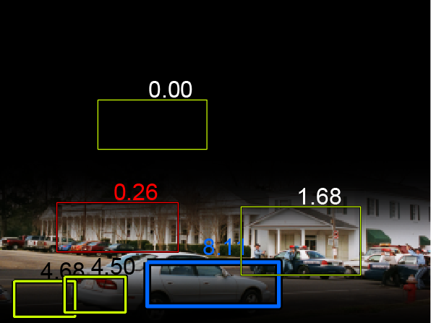
A car out of context …

Slide 22

We are wired for 3D
~6cm

Slide 23
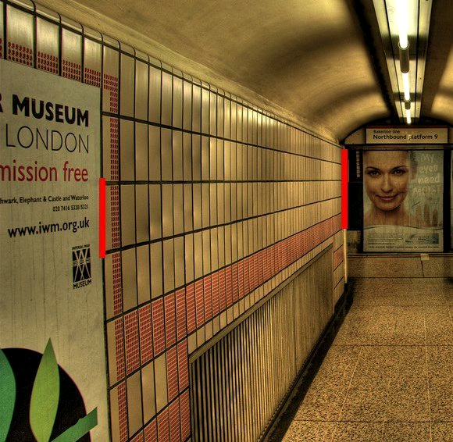
We can not shut down 3D perception
(c) 2006 Walt Anthony

Slide 24
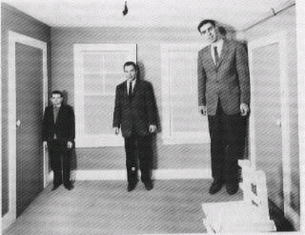
Scenes rule over objects
3D percept is driven by the scene, which imposes its ruling to the objects

Slide 25
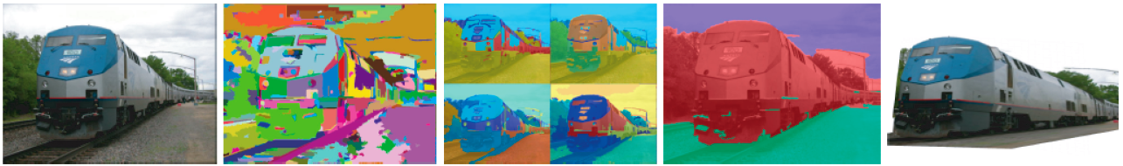
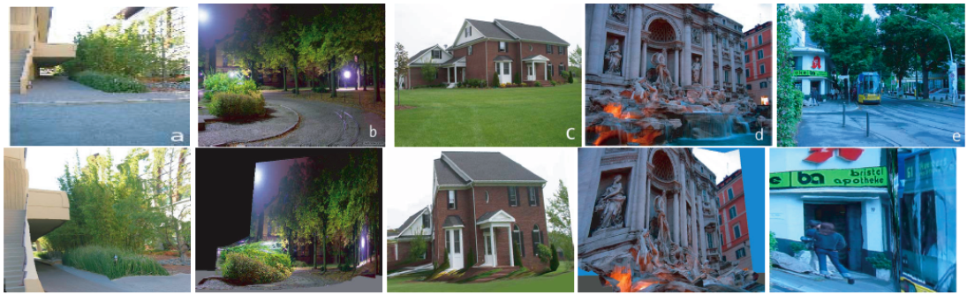
3D from pixel values
D. Hoiem, A.A. Efros, and M. Hebert, "Automatic Photo Pop-up”. SIGGRAPH 2005.
A. Saxena, M. Sun, A. Y. Ng. "Learning 3-D Scene Structure from a Single Still Image"
In ICCV workshop on 3D Representation for Recognition (3dRR-07), 2007.

Slide 26
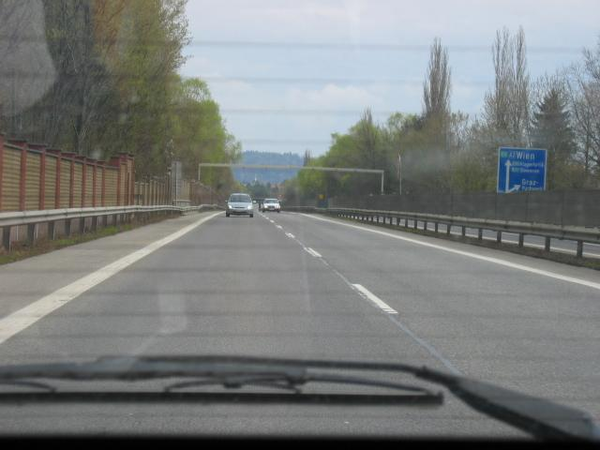
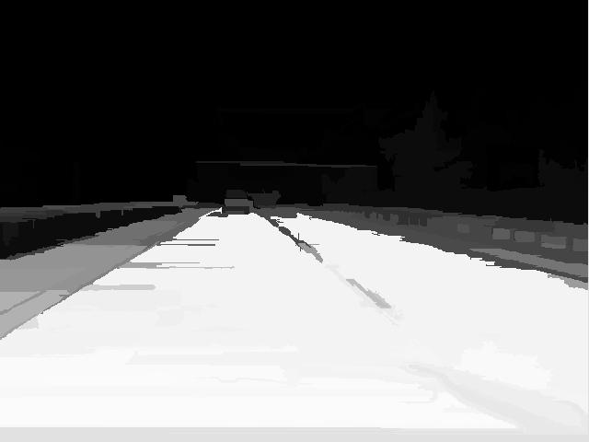







Surface Estimation
Image
Support
Vertical
Sky
V-Left
V-Center
V-Right
V-Porous
V-Solid
Object
Surface?
[Hoiem, Efros, Hebert ICCV 2005]
Support?
Slide by Derek Hoiem

Slide 27
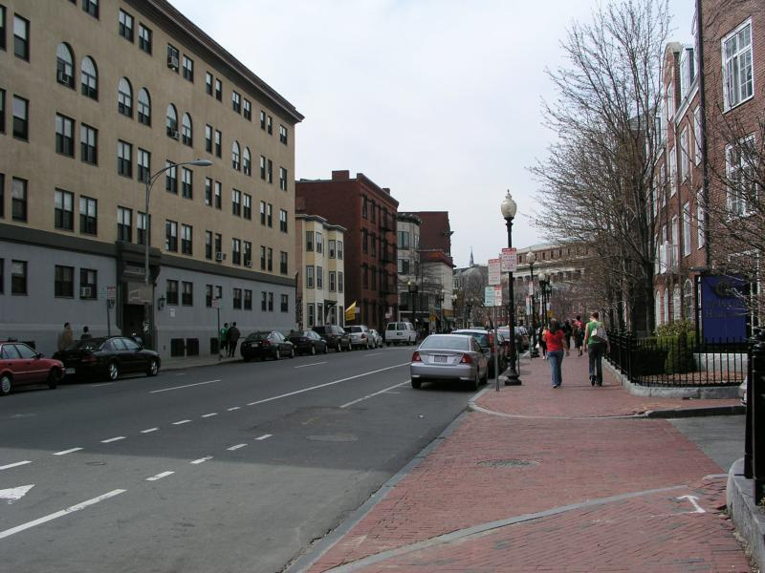
Object Support
Slide by Derek Hoiem

Slide 28
Slide by James Coughlan

Slide 29
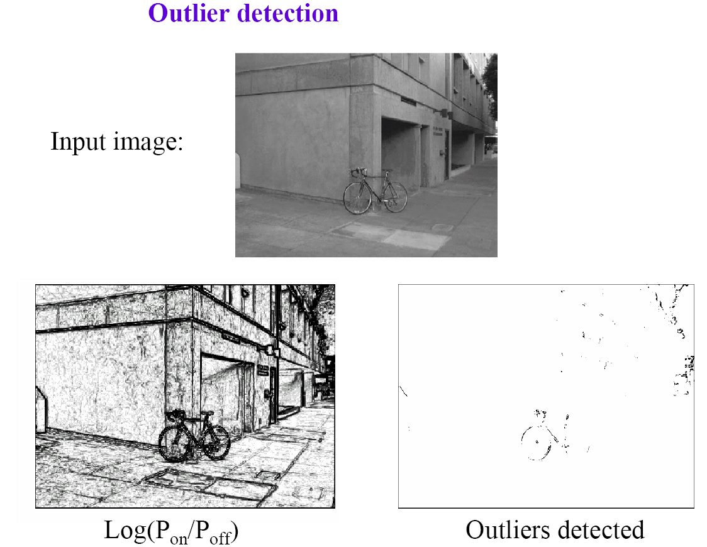
Slide by James Coughlan

Slide 30
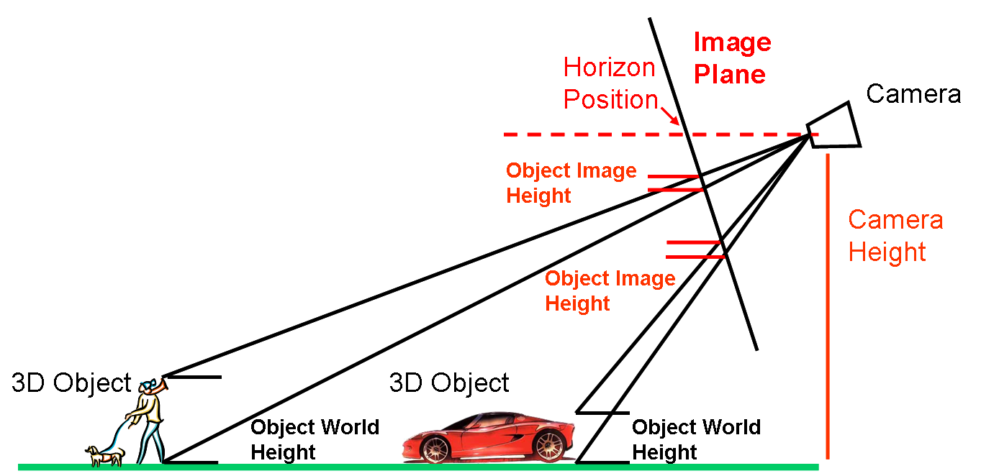
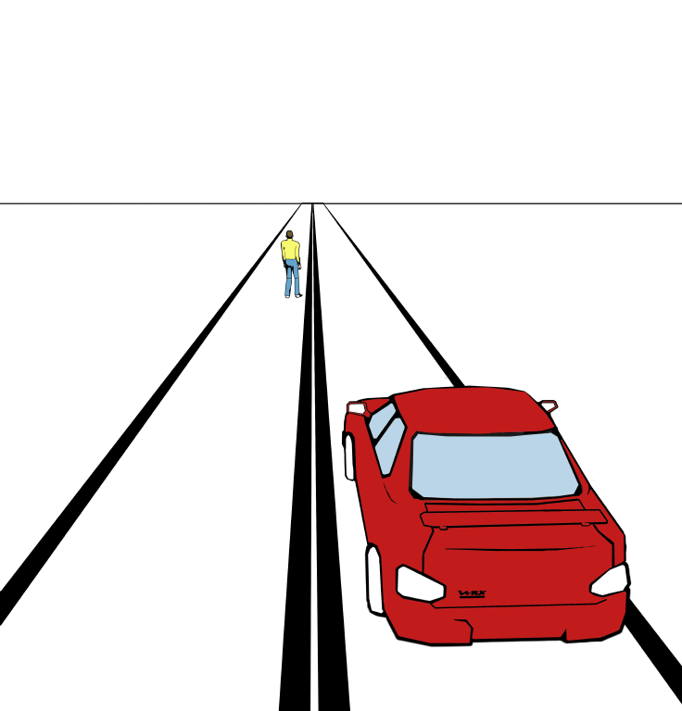
3d Scene Context
Image
World
Hoiem, Efros, Hebert ICCV 2005
Notes:
The object size relationships in the image appear to be very complicated. For instance, it’s hard to determine which is taller: the car or the person? But this question is easily answered if we can look at the relationships in the 3D scene. Fortunately, if the objects all lie on the ground plane, we only need two variables: the horizon and camera height. But how do we determine these parameters from a single image?

Slide 31
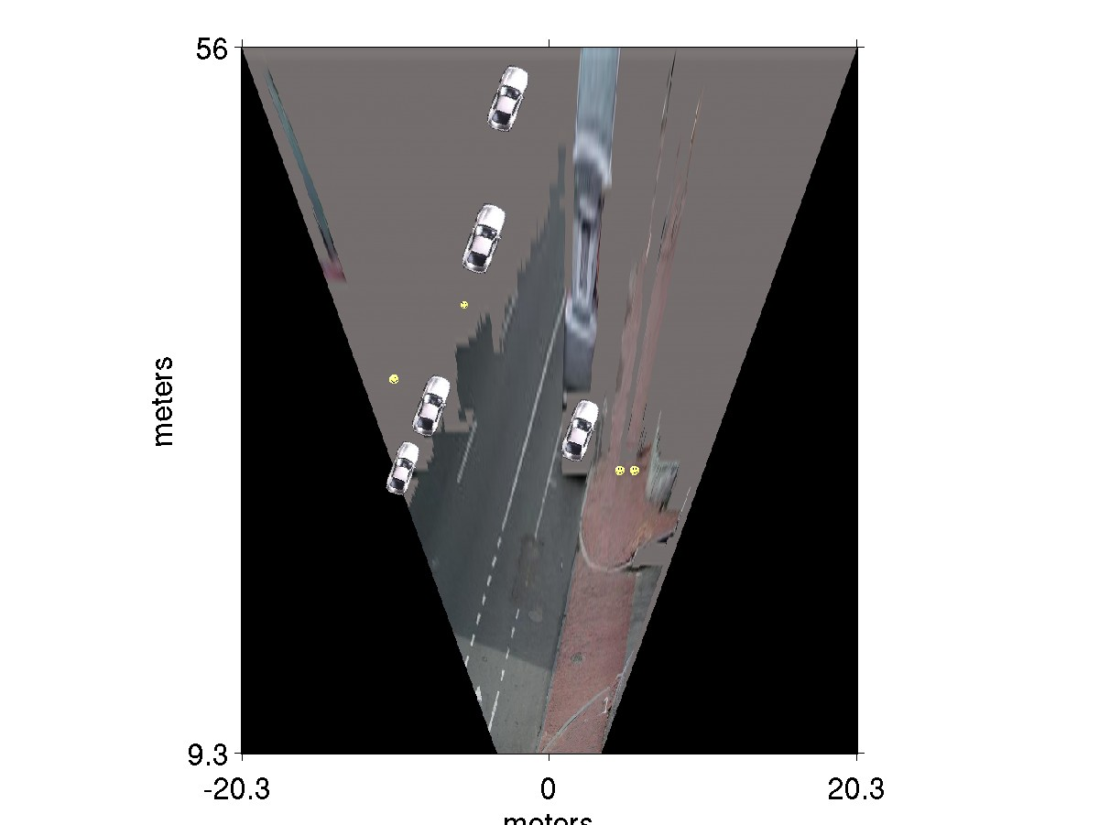
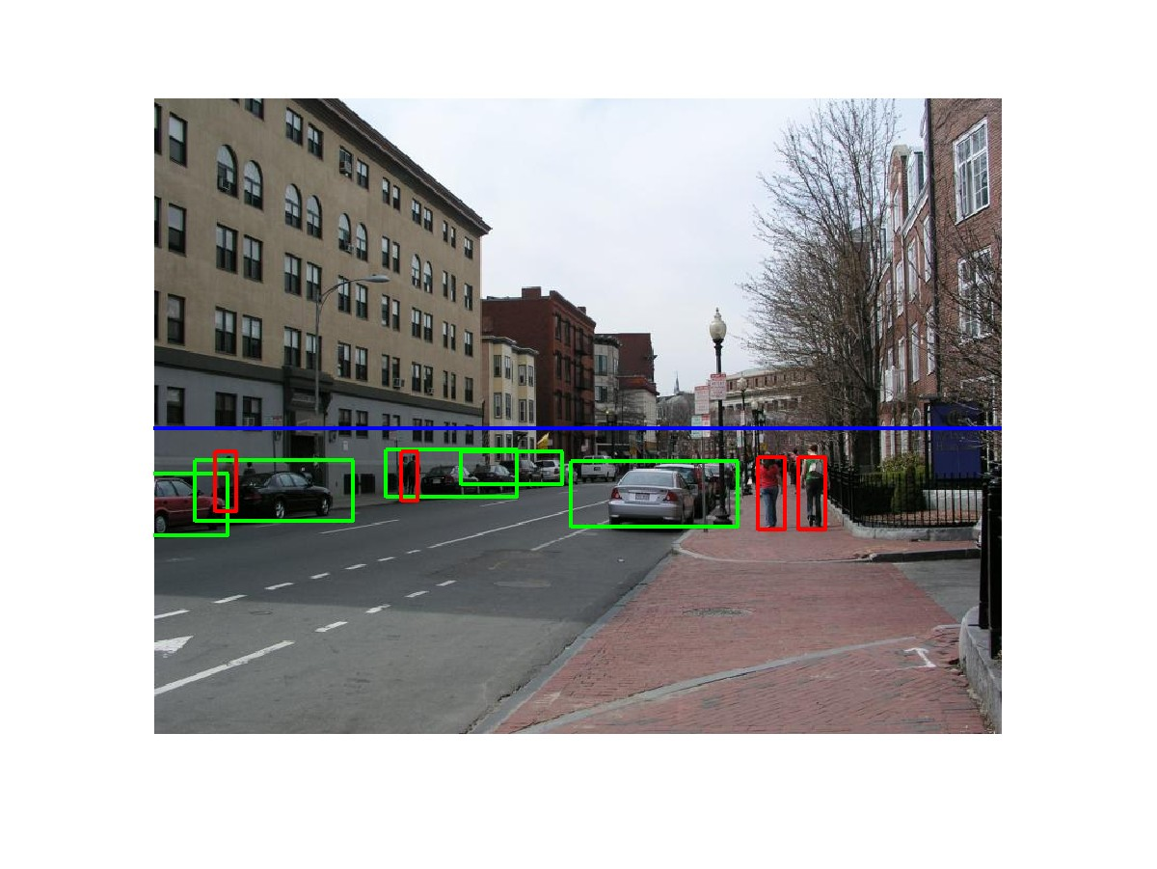
3D scene context
meters
Ped
Ped
Car
meters
Hoiem, Efros, Hebert ICCV 2005
Notes:
…. It’s important to note that these ideas have been around for a long time.

Slide 32
Qualitative Results
Car: TP / FP Ped: TP / FP
Initial: 2 TP / 3 FP
Final: 7 TP / 4 FP
Slide by Derek Hoiem
Local Detector from [Murphy-Torralba-Freeman 2003]

Slide 33
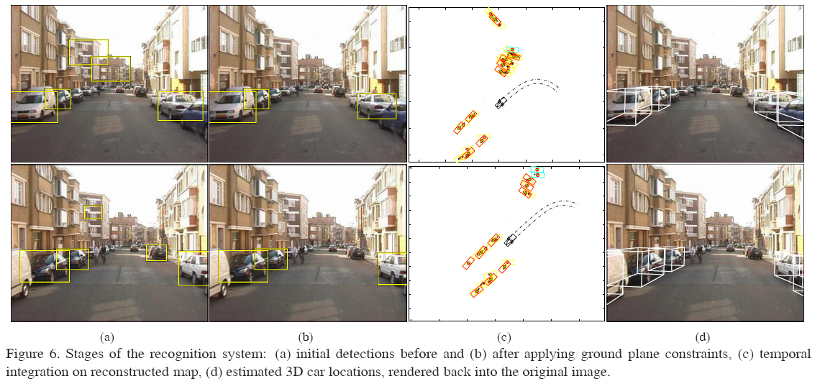
3D City Modeling using Cognitive Loops
N. Cornelis, B. Leibe, K. Cornelis, L. Van Gool. CVPR'06

Slide 34
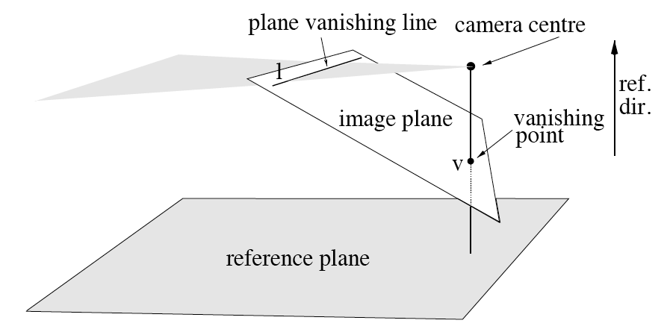
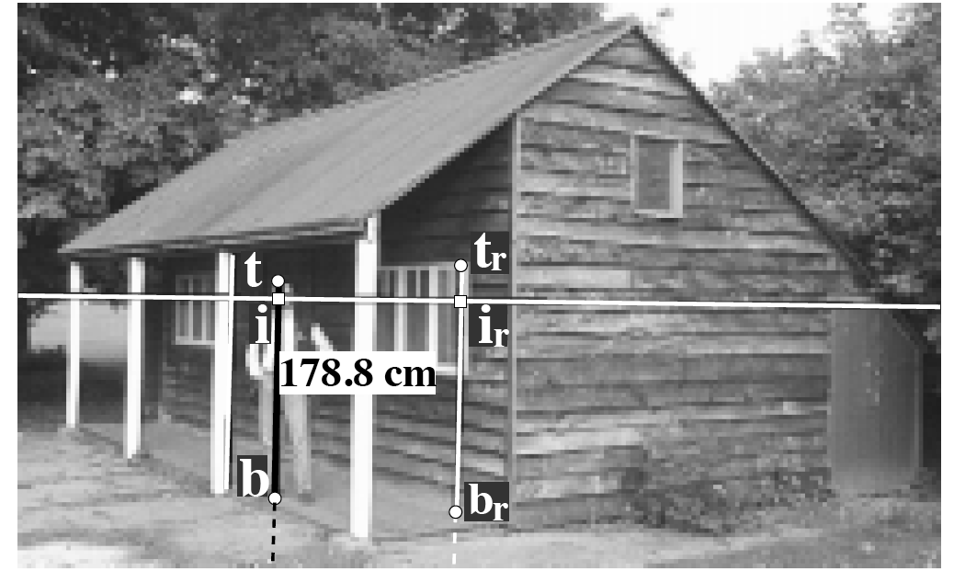
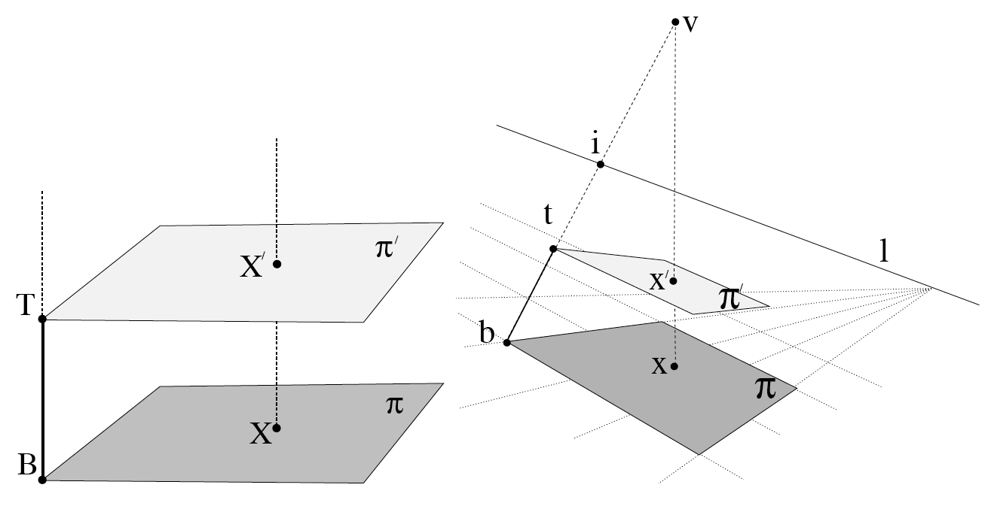
Single view metrology
Criminisi, et al. 1999
Need to recover:
Ground plane
Reference height
Horizon line
Where objects contact the
ground

